Slide 1
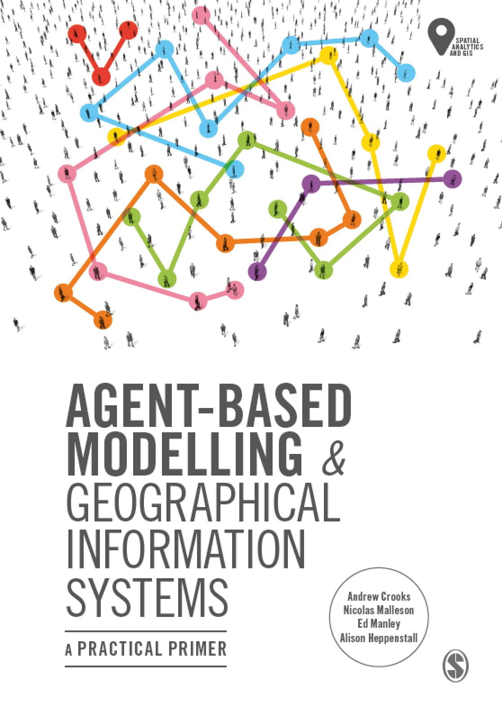
Chapter 5
Fundamentals of Geographical Information Systems
Notes:
This chapter presents the main concepts and terminology that students are required to understand Geographical Information Systems (GIS). The main data types are presented along with a discussion of relevant issues such as accuracy and precision. A brief overview of the development of GIS is given along with a flavour of the main software available. Using QGIS, we demonstrate how to prepare and manipulate some example GIS data. Where appropriate, we highlight the main issues that need to be considered when using a GIS and agent-based modelling.

Slide 2
Learning Objectives

Slide 3
Introduction
Whatever occurs, occurs in space and time. Therefore our perception of the world is inherently spatial and temporal: objects have a location, and events are embedded in a stream of time. (Wegener, 2000)

Slide 4
Introduction

Slide 5
A (Very Brief) History of GIS

Slide 6
Representing the World

Slide 7
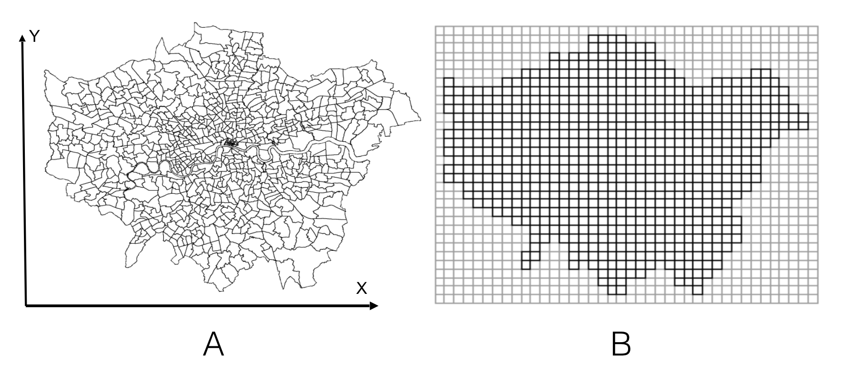
Representation: Vector & Raster
Figure 5.1: An Example of a Vector (A) and Raster (B) of Wards (administrative units) in the Greater London Authority area.

Slide 8
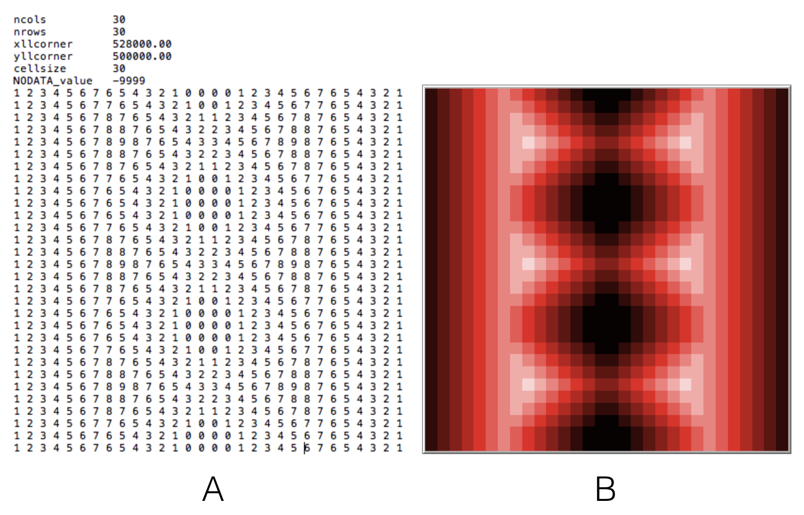
Raster Data
For the Model see ImportRasterSample
Figure 5.2: An Example of reading in a raster data and creating a landscape. (A) the original ASCII file from a GIS. (B): the resulting space created in NetLogo.
Notes:
Model example called ImportRasterSample

Slide 9
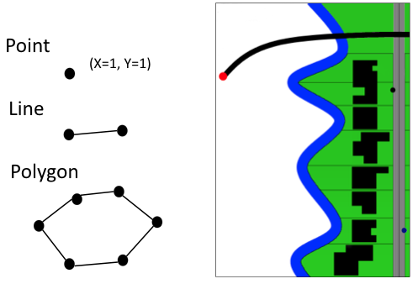
Vector Data
Figure 5.3: The basic building blocks of vector data: Points, lines and polygons. Different types of objects can be combined to represent geometric properties of an area.

Slide 10
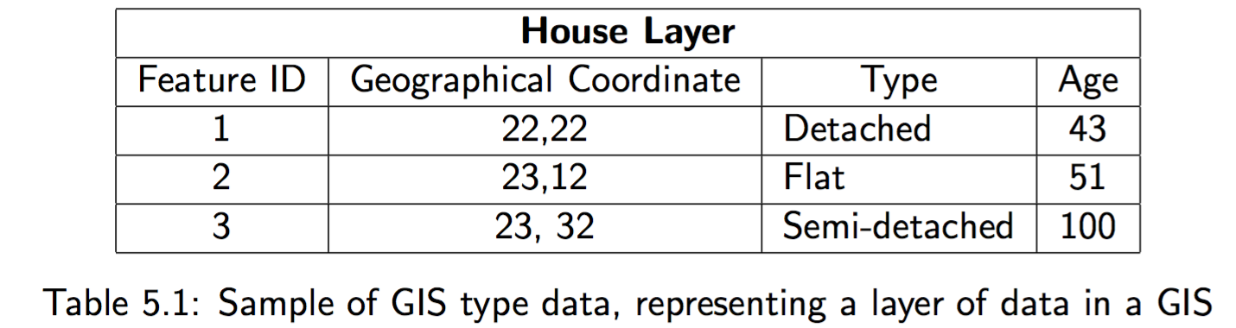

Slide 11
Time in GIS

Slide 12
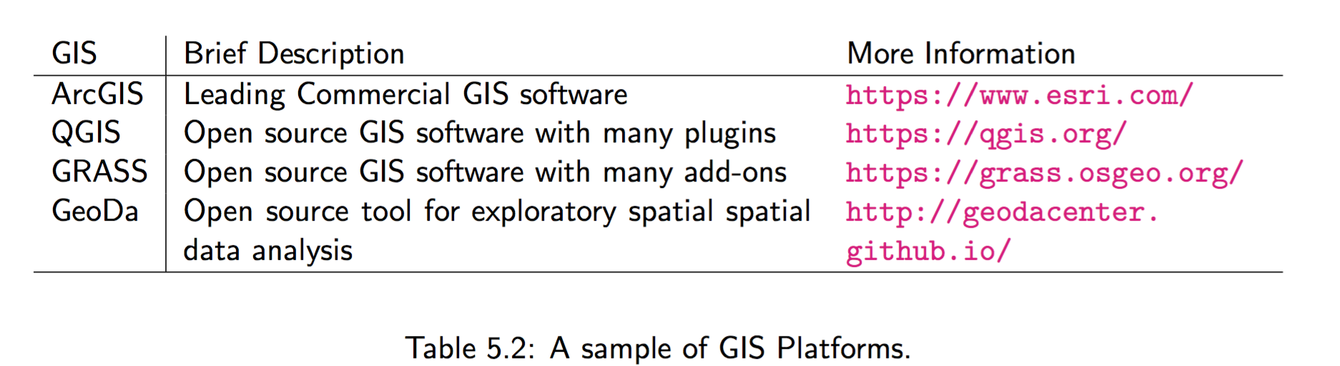
GIS Software

Slide 13
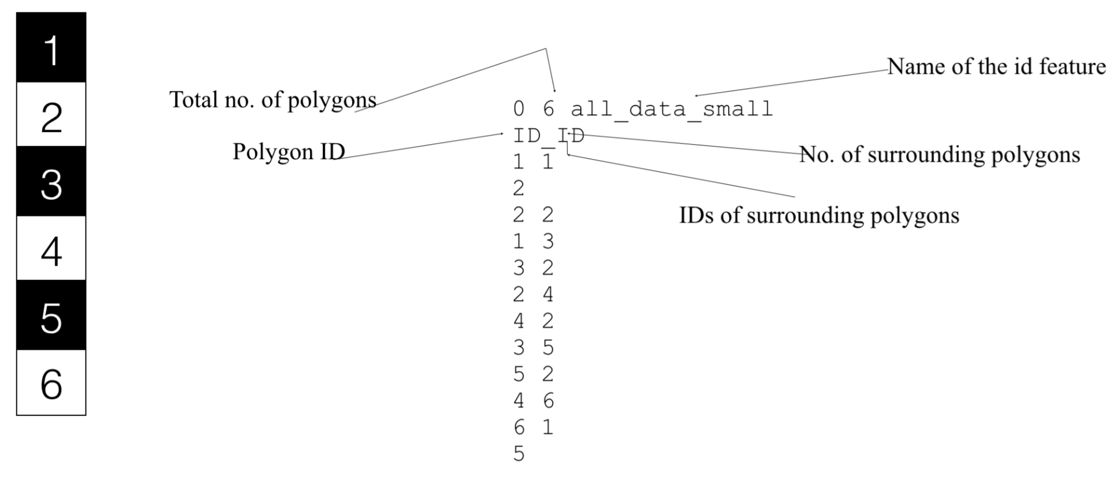
Figure 5.4: Using GeoDa to create a .GAL file. On the left we have a collection of polygons (objects) and right the the .GAL file where each polygon records its neighbors.
Notes:
(we use such an approach in Section 6.6).

Slide 14
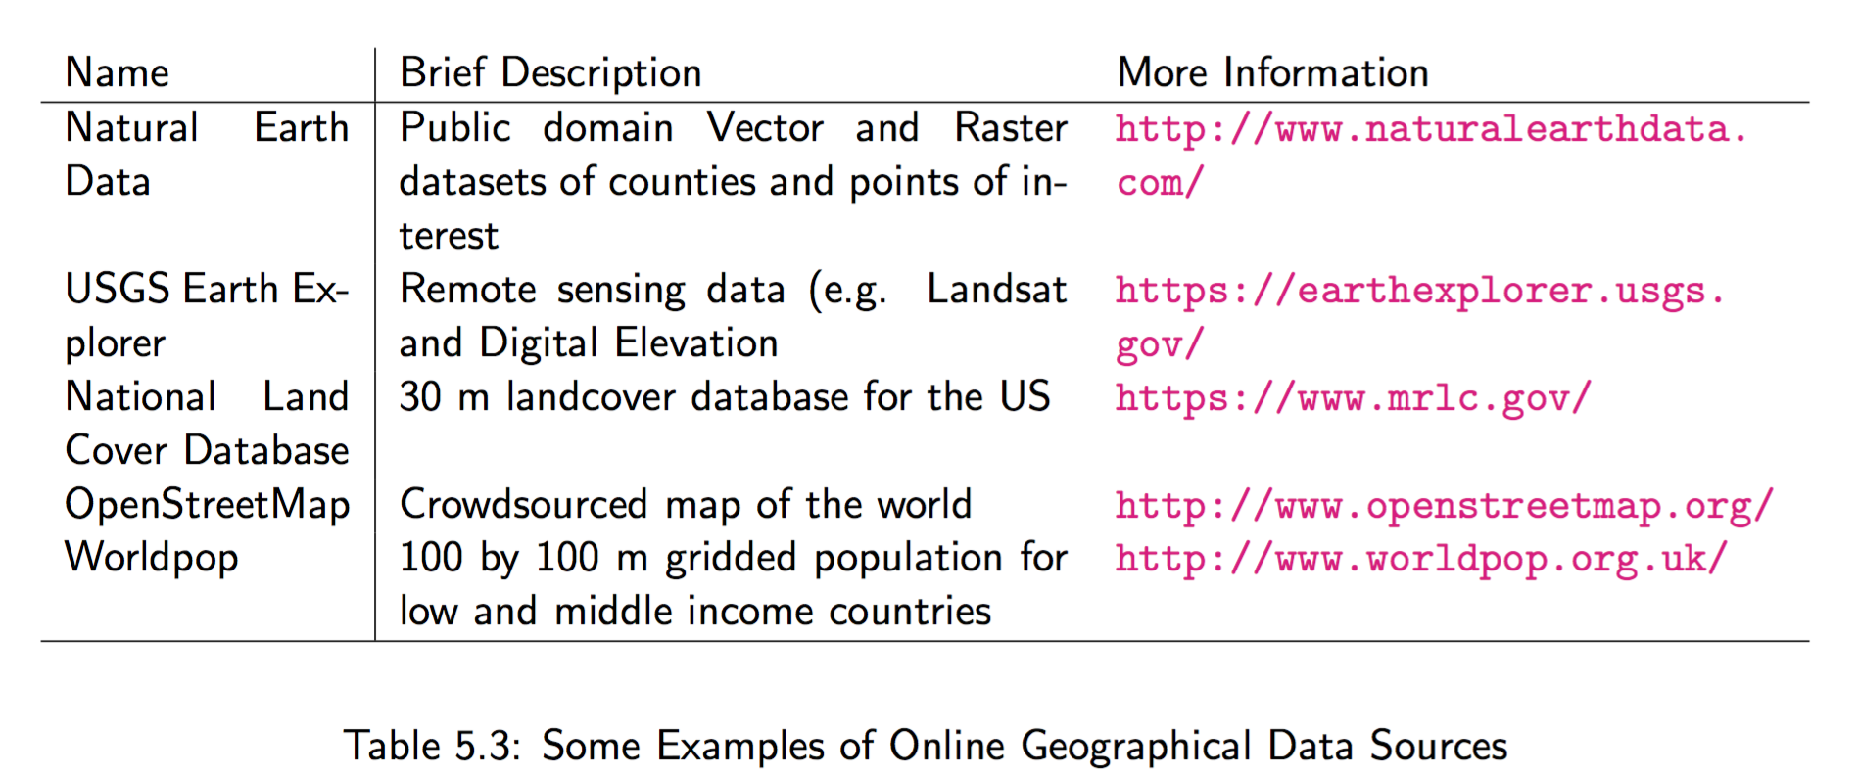
Sources of Geographic Data

Slide 15
Volunteered and Ambient Geographical Information

Slide 16
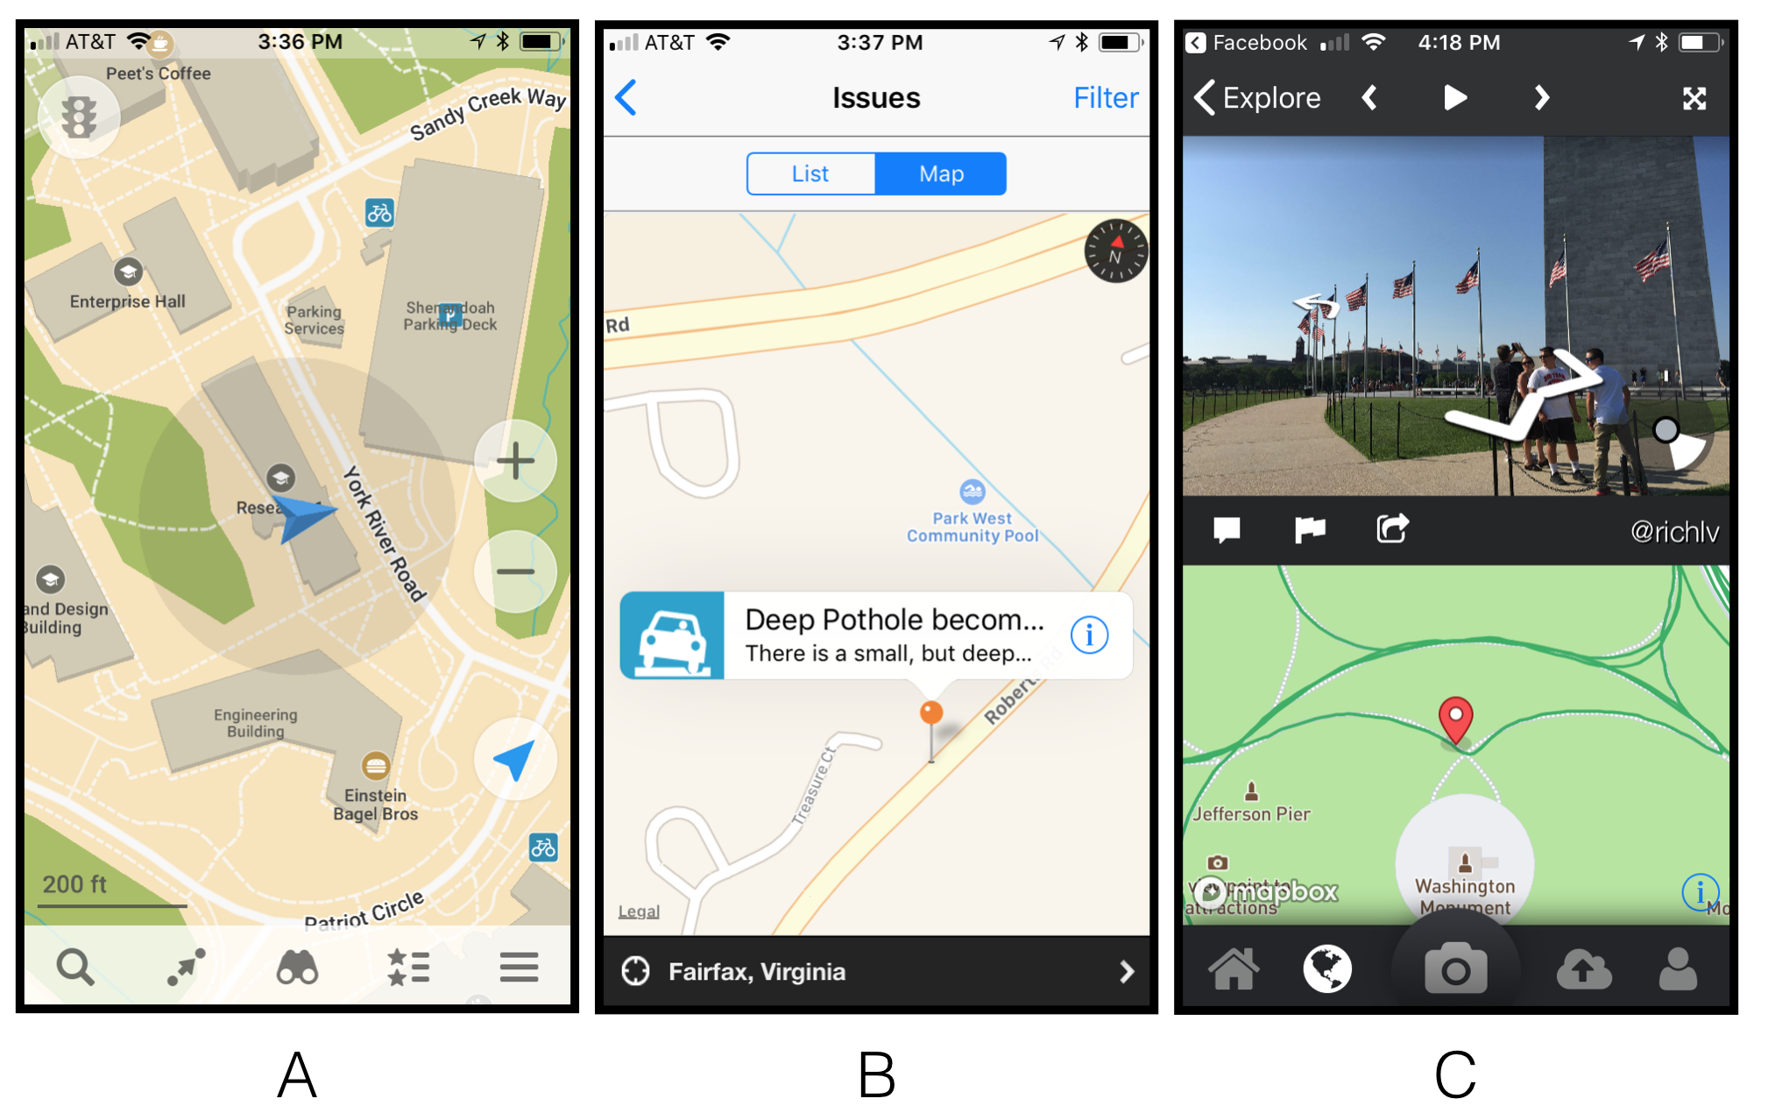
Figure 5.5: Examples of volunteered geographical information. A: Maps.Me, B: SeeClickFix C: Mapillary

Slide 17
Social Media Data

Slide 18

GeoSocial Analysis
Figure 5.6: GeoSocial Analysis: linking places, people and events

Slide 19
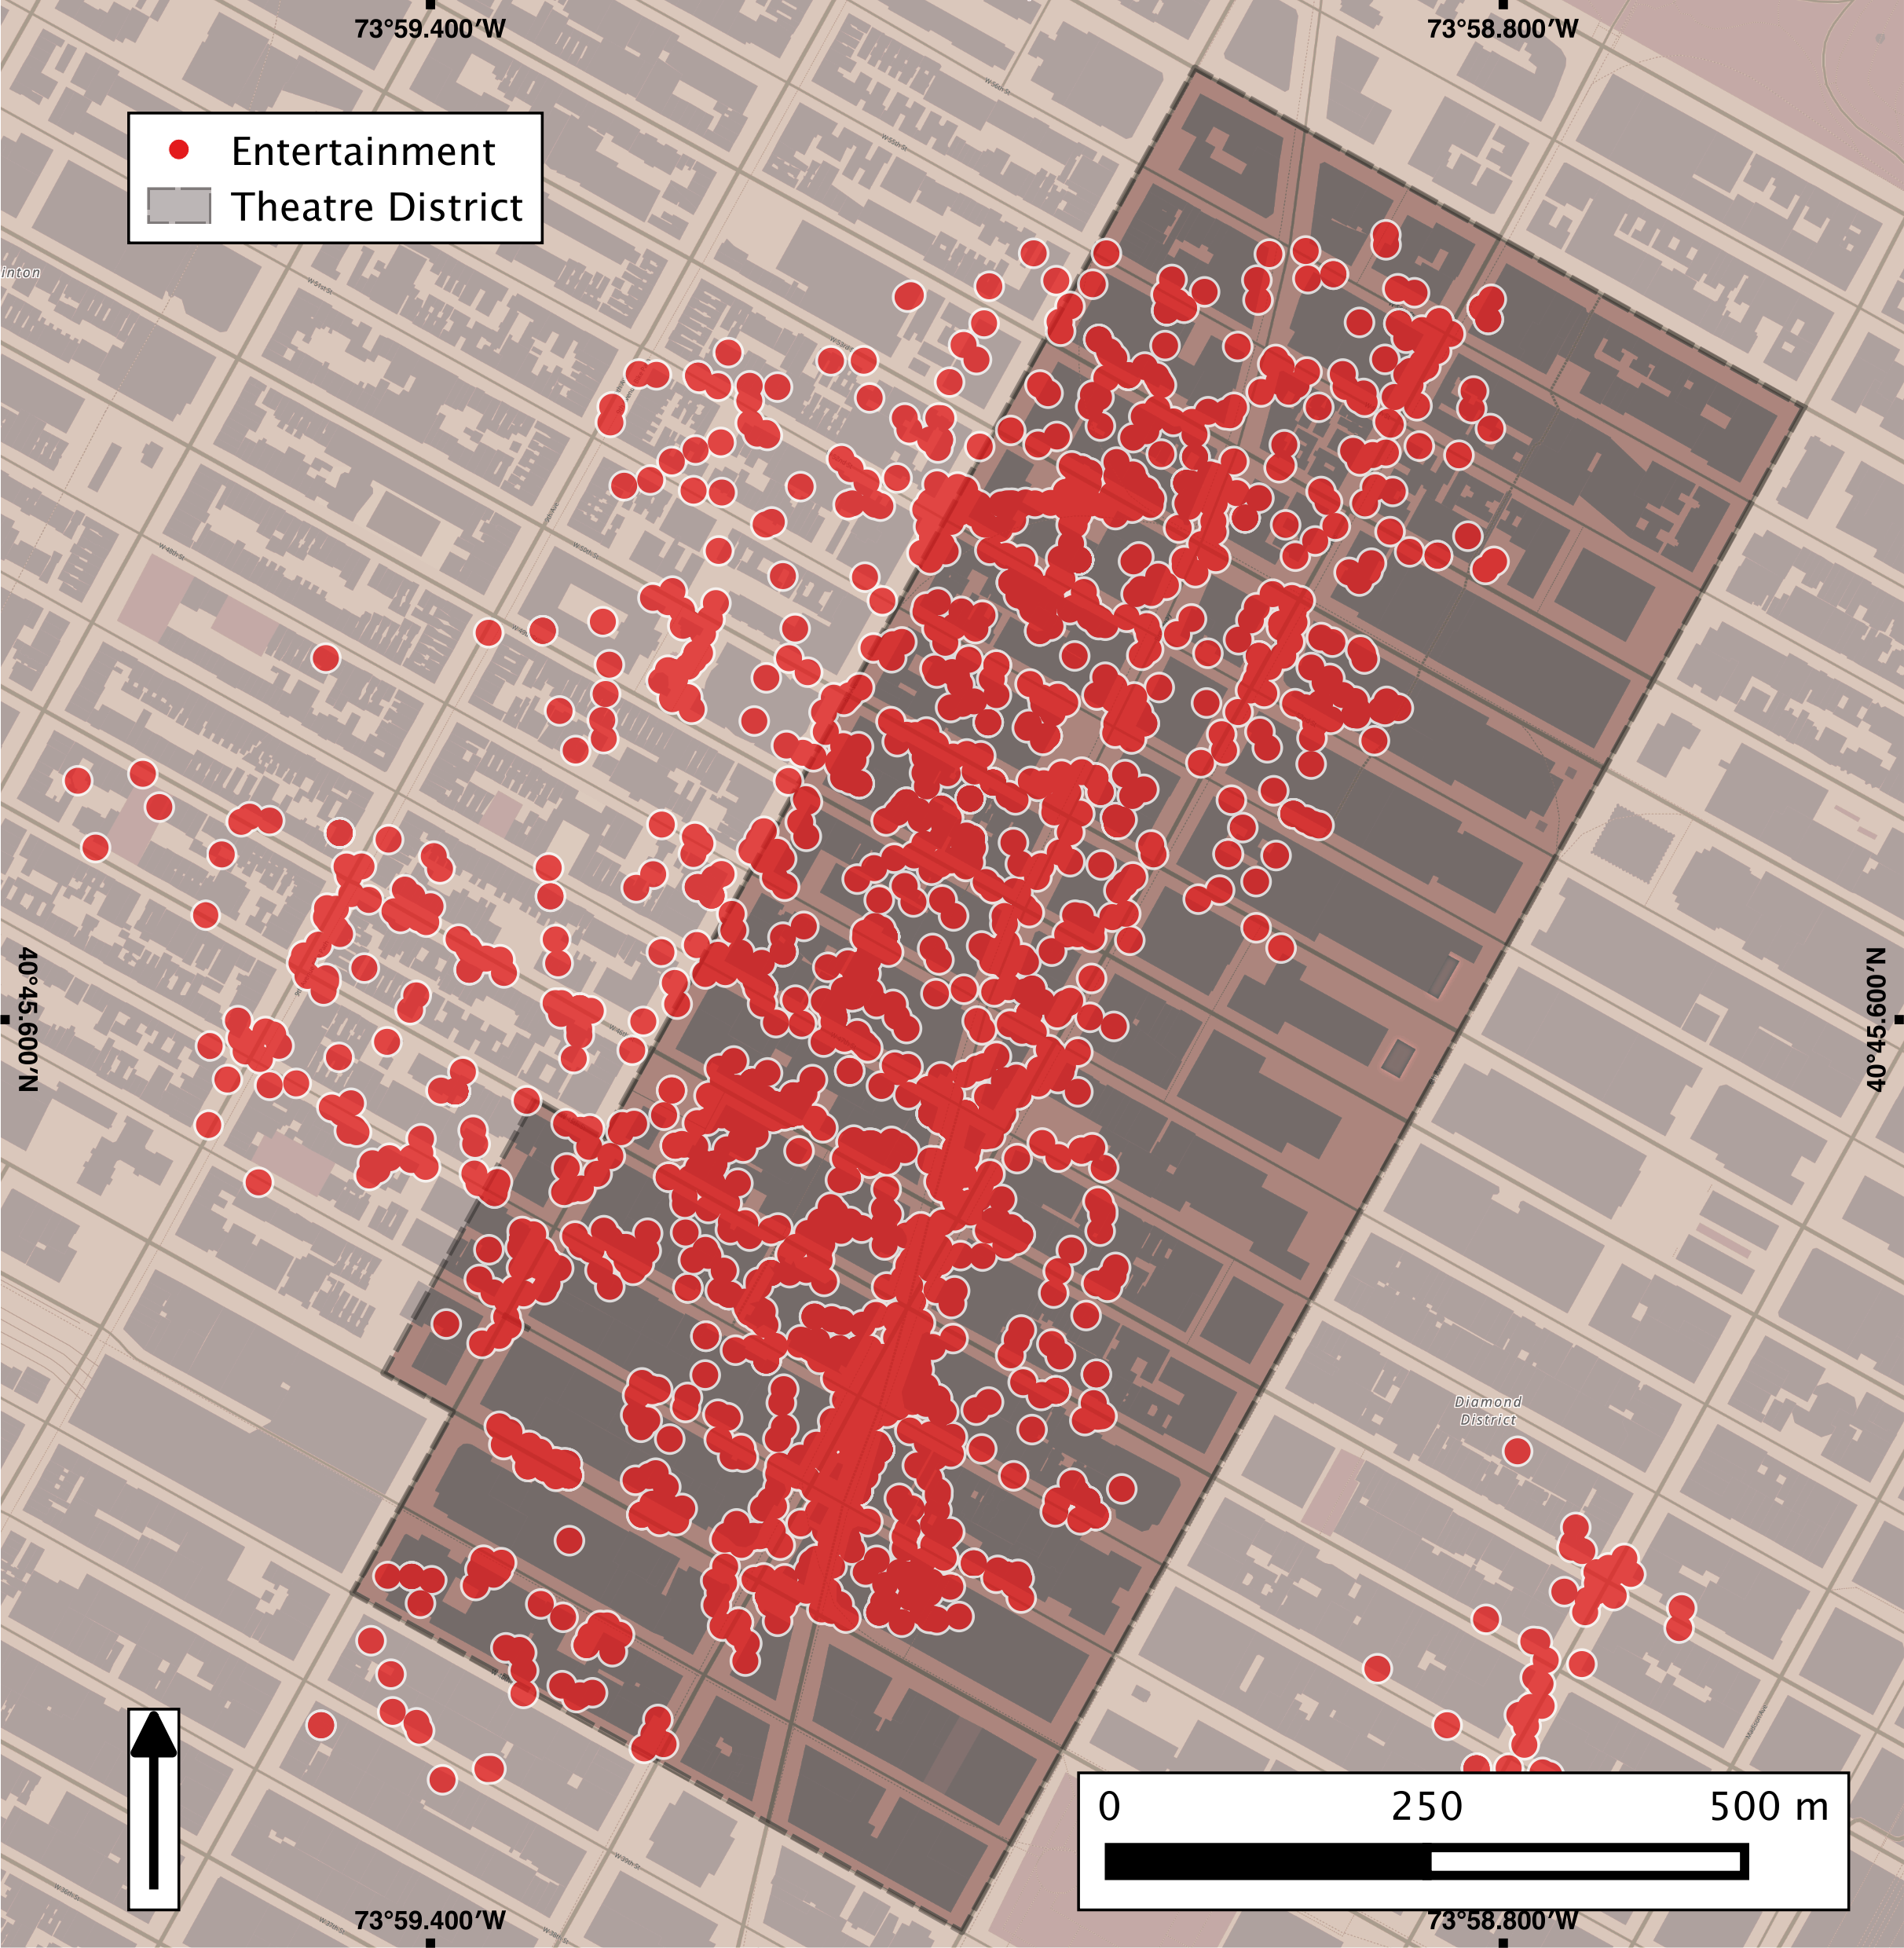
Figure 5.7: Mining tweets relating to entertainment and contained within and nearby the Theatre Sub District of New York city (Source: Jenkins et al., 2016)

Slide 20
Remotely Sensed Data

Slide 21
Visualising Results

Slide 22
Map Types

Slide 23
Figure 5.13: A dot density map of income distributions in Winnipeg, Canada, constructed from 2006 Census data.

Slide 24
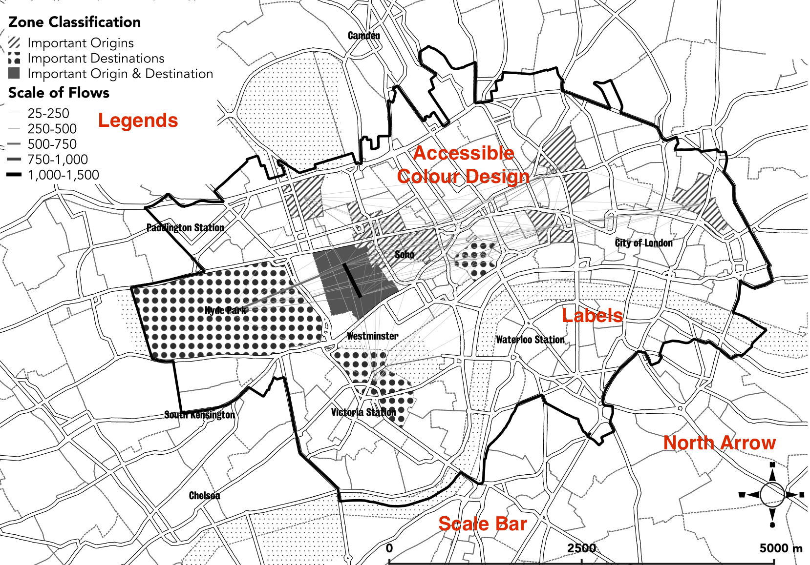
Map Elements
Figure 5.14: Map from Demsar et al. (2018) that demonstrates strong map design, through inclusion of a legend, scale bar, supporting labels, north arrow, and accessible color design.

Slide 25
Styling Trends

Slide 26
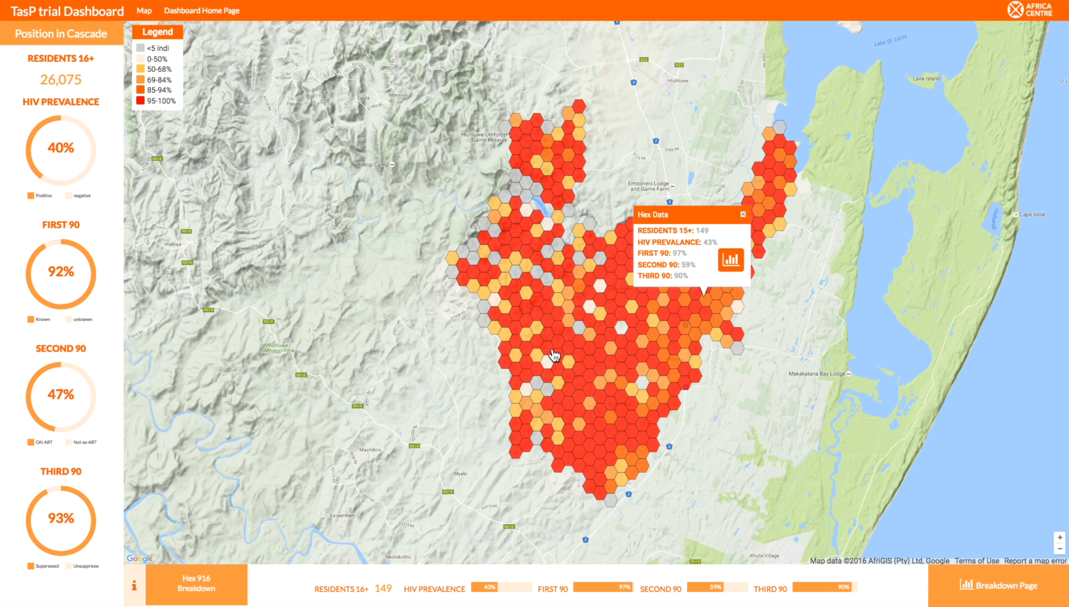
Interactivity
Figure 5.15: A screenshot of the TasP trial dashboard installed at the Africa Health Research Institute in Kwa-Zulu Natal, South Africa, which enables interactive exploration of global and local trends in HIV rates, and combines hexagon-based choropleth mapping with supporting figures, graphs and text-based notes.

Slide 27
Discussion
Notes:
Geographical Information Systems (GIS) are the mainstay of many researchers tool box. The ability to easily manipulate, analyse and visualise data makes it a powerful tool. However, researchers need to be aware of the underlying principles behind GIS, such as the data structures that are used and the limitations of GIS, in particular, its limited ability to handle and simulate dynamic processes. This Chapter has laid out the fundamental concepts that researchers need to be aware of, and presented an overview of the most common proprietary packages. A simple tutorial demonstrated how to bring data into a GIS and perform a simple spatial query. The next chapter will build upon this foundation and introduce the concept of coupling GIS with ABM.

Slide 29
Further Reading
Lastly, for a more detailed discussion of all the techniques discussed in this chapter and their history, readers are referred to the following excellent resources:
Gilbert, N. and Troitzsch, K.G. (2005) Simulation for the Social Scientist (2nd ed.). Maidenhead: Open University Press.
Shiflet, A.B. and Shiflet, G.W. (2014) Introduction to Computational Science: Modeling and Simulation for the Sciences (2nd ed). Princeton, NJ: Princeton University Press.
Sterman, J.D. (2000) Business Dynamics: Systems Thinking and Modeling for a
Complex World. Boston: McGraw-Hill.
Wolfram, S. (2002) A Knew Kind of Science. Champaign, IL: Wolfram Media.

Slide 30
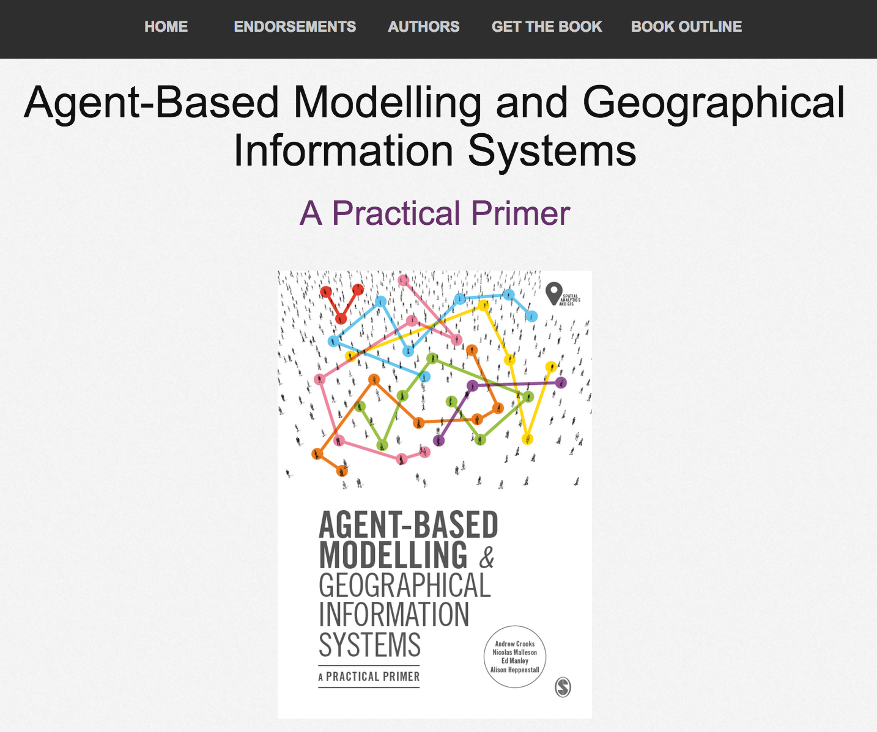
Online Resources
Visit: https://github.com/abmgis/abmgis/tree/master/Chapter05-GIS for a selection of models to highlight core concepts introduced in this chapter

